Slide 1
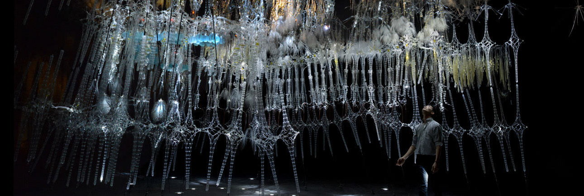
Curiosity-Based Learning Algorithm for Interactive Art Sculptures
Image courtesy of Philip Beesley Architect Inc.
Matthew Tsz Kiu Chan Feb 09, 2016
Notes:
(00:15) 15s
Show how we implement CBLA on interactive art sculpture

Slide 2
Outline
Introduction
Curiosity-Based Learning Algorithm
Interactive Control System
Experimental Validation
User Study
Conclusions and Future Work
Notes:
(00:45) 30s

Slide 3
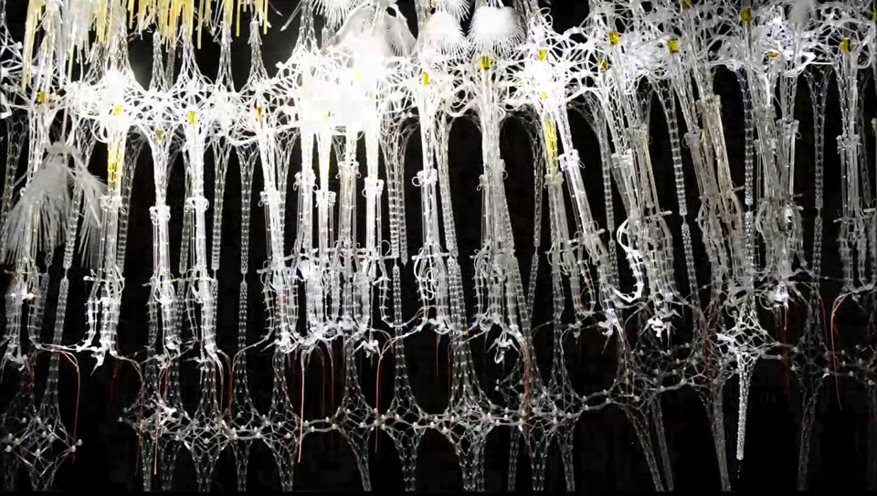

Motivations
Aim to create large-scale interactive architectural installations that exhibit life-like qualities.
Believe that it needs to be able to generate varying interactive behaviours autonomously.
Epiphyte Chamber by Philip Beesley Architecture Inc.
https://vimeo.com/80905751
Notes:
(02:05) 80s
We are part of LASG.
PBAI made architectural scale installation.
Want to find out if architecture can be alive.
Able to generate varying interactive behaviours, not programmed by people.

Slide 4
Objectives
To enable the sculptural system to generate varying behaviours autonomously.
To characterize these autonomous behaviours and the system’s responses to human interactions.
To study the responses and perceptions of the users.
Notes:
(02:35) 30s
Believe that this is more life-like and, thus, more interesting.
Characterize the behaviours emerged when interesting with human.
Study how people see it.

Slide 5
Approach
Introduce the Curiosity-Based Learning Algorithm (CBLA)
Recasts the sculptural system as a set of agents driven by an intrinsic desire to learn.
Based on the Intelligent Adaptive Curiosity (IAC) algorithm (Oudeyer, 2007).
Build an experimental test bed implementing the CBLA
Conduct experiments and user study on the test bed
Compare results under different configurations and against the non-varying prescripted behaviours.
Notes:
(03:25) 50s
Generate varying behaviours by mimicking curiosity.
CBLA adapted from IAC.
Reinforcement learning algorithm with expected learning progress as reward.
Studying the action generated in the learning process; not trying to use the learnt model.
Build a test bed that implement the CBLA.
Test it on its own and with users.

Slide 6
Contributions
An algorithm for generating autonomous behaviours for a large scale kinetic sculptural system during interaction with an occupant was developed.
A test bed including new electronic hardware and software architecture was built to enable physical realization of the approach.
A user study was conducted to examine how human occupants perceive the behaviours of the sculpture and respond in turn.
Notes:
(03:55) 30s
CBLA Algorithm.
Test bed hardware and software to run CBLA.
User study examining user’s perceptions.
(Total: 235s = ~4min)

Slide 7
Introduction
Curiosity-Based Learning Algorithm
Interactive Control System
Experimental Validation
User Study
Conclusions and Future Work
Notes:
(04:00) 5s

Slide 8
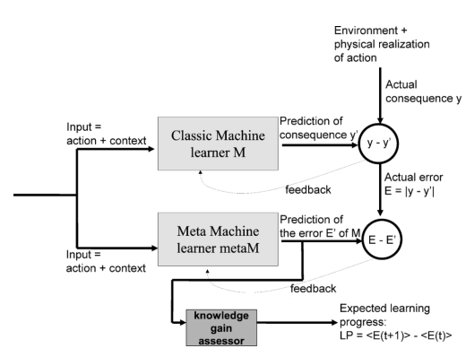
Intelligent Adaptive Curiosity (IAC)
Oudeyer, P., Kaplan, F., & Hafner, V. V. (2007). Intrinsic motivation systems for autonomous mental development. IEEE Transactions on Evolutionary Computation, 11(2), 265-286
classM predicts consequence of action given context.
metaM predicts error in classM’s prediction.
LP is the expected reduction of error in similar sensorimotor context.
Notes:
(05:25) 1:25
classM and metaM.
LP computes by expected prediction Error
LP is the reward to the reinforcement learning algorithm.
In this case, it is the reduction in prediction error in similar sensorimotor context.
Maximizing of learning progress is how it mimics curiosity.

Slide 9
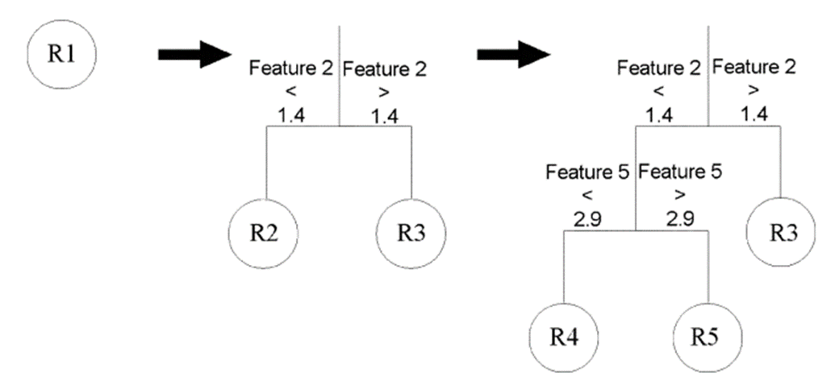
Intelligent Adaptive Curiosity (IAC)
Oudeyer, P., Kaplan, F., & Hafner, V. V. (2007). Intrinsic motivation systems for autonomous mental development. IEEE Transactions on Evolutionary Computation, 11(2), 265-286
The state-space splits into regions over time.
Each region represents a set of similar sensorimotor context.
Learning progress is evaluated within each region.
Agent selects actions with the highest expected learning progress.
Notes:
(05:10) 45s
Learning progress evaluated in similar situation.
Start with one region, representing sensorimotor context.
Split over time.
Robot selects action with max LP.

Slide 10
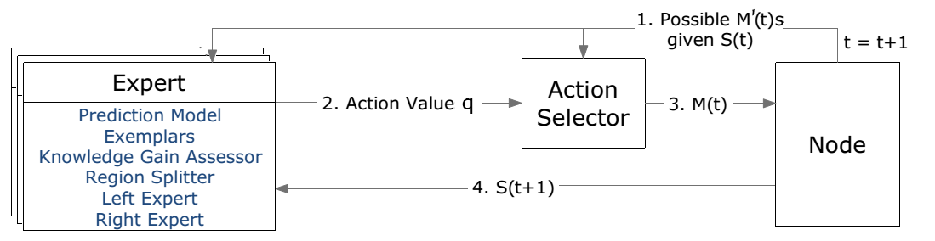
Curiosity-Based Learning Algorithm (CBLA)
CBLA adapts the IAC algorithm for a distributed kinetic sculpture which has hundreds of sensors and actuators.
Each Node
represents a subset of the system.
has a CBLA Engine made up of an Action Selector and a set of Experts.
starts with one Expert and splits into more regions over time.
Notes:
(05:45) 35s
IAC -- a single robot with a handful of input and output variables.
CBLA -- a larger system with hundreds of actuators and sensors.
Split the system into multiple Nodes. Make state-space smaller speeds up learning.
There is an action selector and multiple experts.

Slide 11
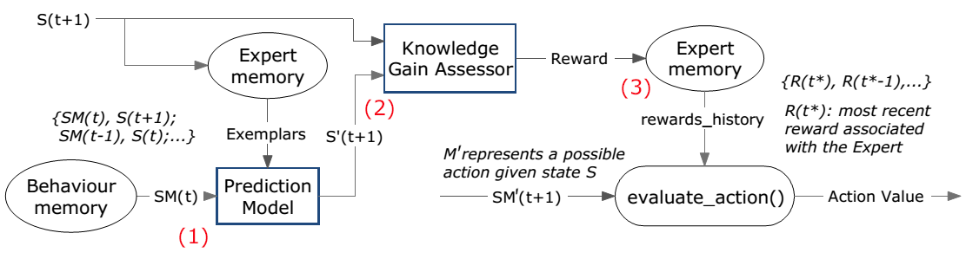
Experts
An Expert associated with the current sensorimotor context is selected to make a prediction of the consequence S’(t+1).
The reward is evaluated by the Knowledge Gain Assessor (KGA).
The Action Selector queries the Expert for the action value associated with its sensorimotor context.
Notes:
(06:35) 50s
An Expert associated with each sensorimotor context within a Node.
Expert make prediction using linear model.
KGA evaluates the rewards.
Action Selector then evaluate actions associated with the region by using its action value.

Slide 12
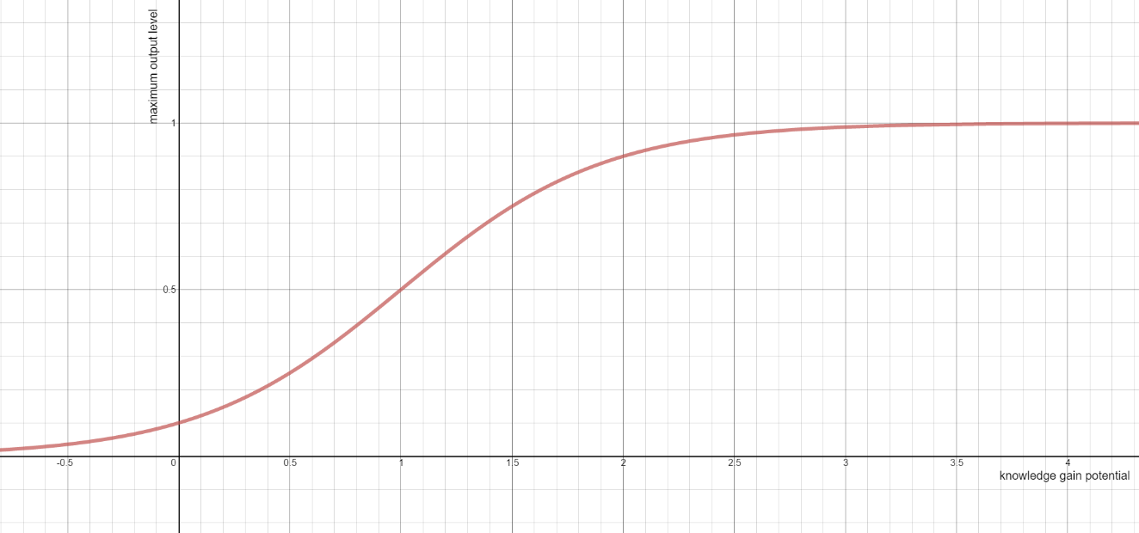
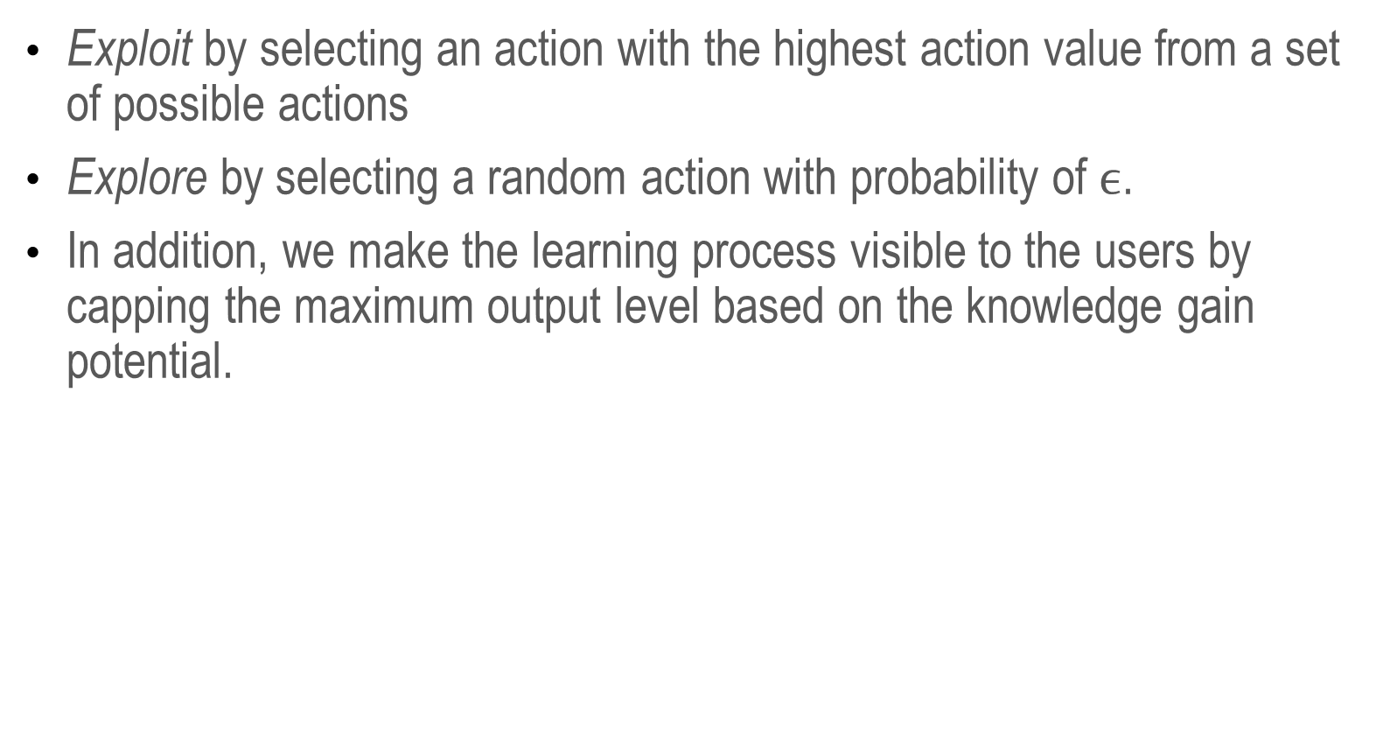
Action Selector
Exploit by selecting an action with the highest action value from a set of possible actions
Explore by selecting a random action with probability of $ϵ$.
In addition, we make the learning process visible to the users by capping the maximum output level based on the knowledge gain potential.
Notes:
(07:25) 50s
E-greedy action selection method.
Make learning process visible by adjusting max output.
Analogous to being bored.

Slide 13
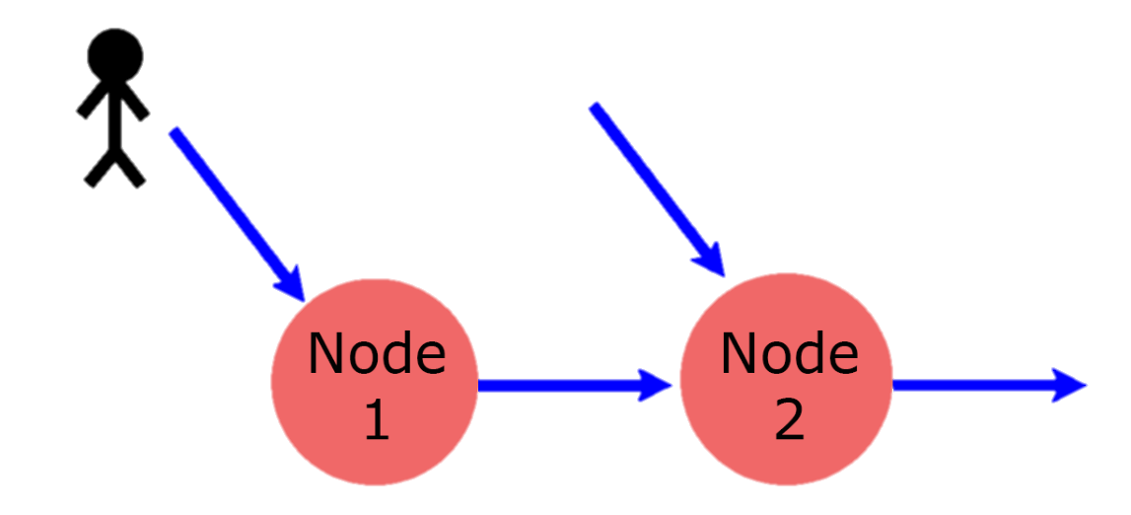
Multi-Node CBLA System
Subset of related variables are grouped into Nodes with each running its own instance of the CBLA Engine.
Each Node runs independently and asynchronously.
Nodes are connected to each other via shared inputs and virtual inputs.
Varying and interesting behaviours can emerge through the learning process as the CBLA system selects actions that elicit new responses from users.
Notes:
(08:35) 1:10
Shared inputs -- inputs to multiple Nodes.
Virtual inputs -- indirect information.
CBLA can generate varying actions through learning process.
It wants to learn so it will generate action that elicit respond
(Total: 340s = ~5.5 min)

Slide 14
Introduction
Curiosity-Based Learning Algorithm
Interactive Control System
Experimental Validations
User Study
Conclusions and Future Work
Notes:
(08:40) 5s

Slide 15
Interactive Control System
New Hylozoic Series 3 was developed in order to implement the CBLA system.
CBLA system requires a large number of sensors and actuators and computational power that previous series of the electronics system were unable to provide.
This also allows high-level abstraction of the sculptural system.
Notes:
(09:10) 30s
Old system didn’t have the capability.
High-level abstraction possible.
Create CBLA Node made up of any components.

Slide 16
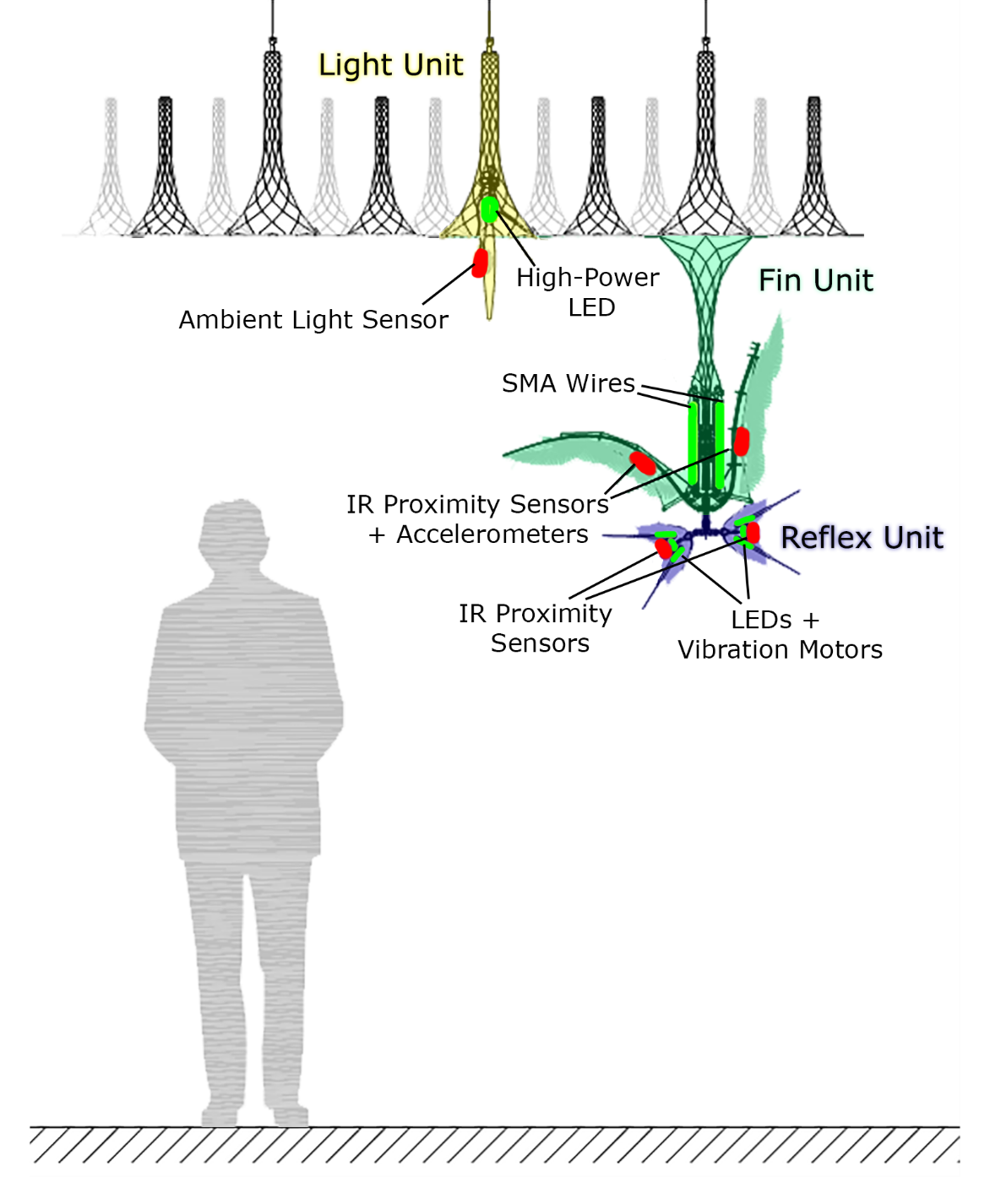
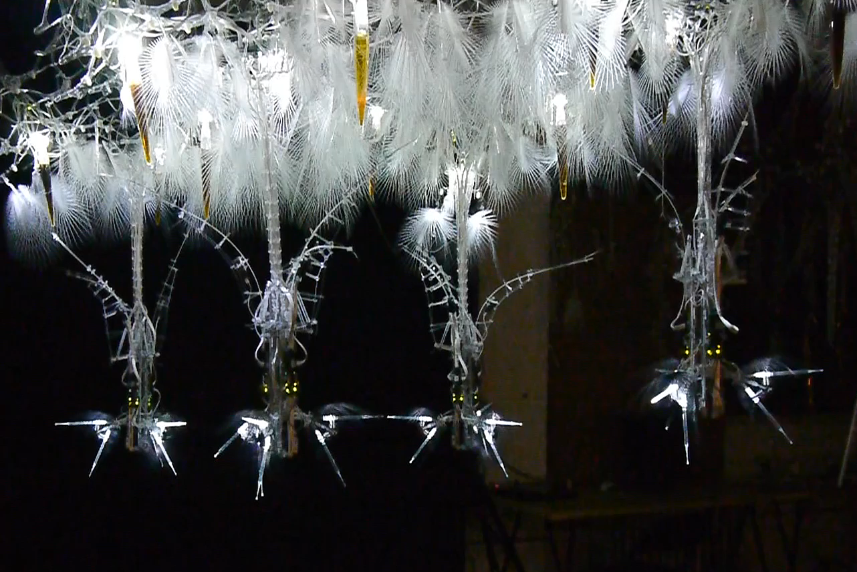
Hardware Components
Notes:
(09:55) 45s.
In collaboration with staff at PBAI, and Mo Memarian.
Three sets of Fin Unit, Reflex Unit, Light Unit. Four clusters.
Smaller than typical installation however.
It is used for user study.

Slide 17
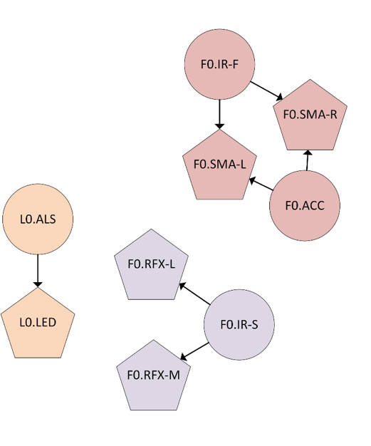
CBLA Nodes
Three types of CBLA Nodes
Half-Fin
Light
Reflex
CBLA Nodes were connected either in Spatial Mode or Random Mode.
Notes:
(10:25) 30s
Each actuator per CBLA Node.
Three types of CBLA Nodes.
Spatial Mode and Random Mode.

Slide 18
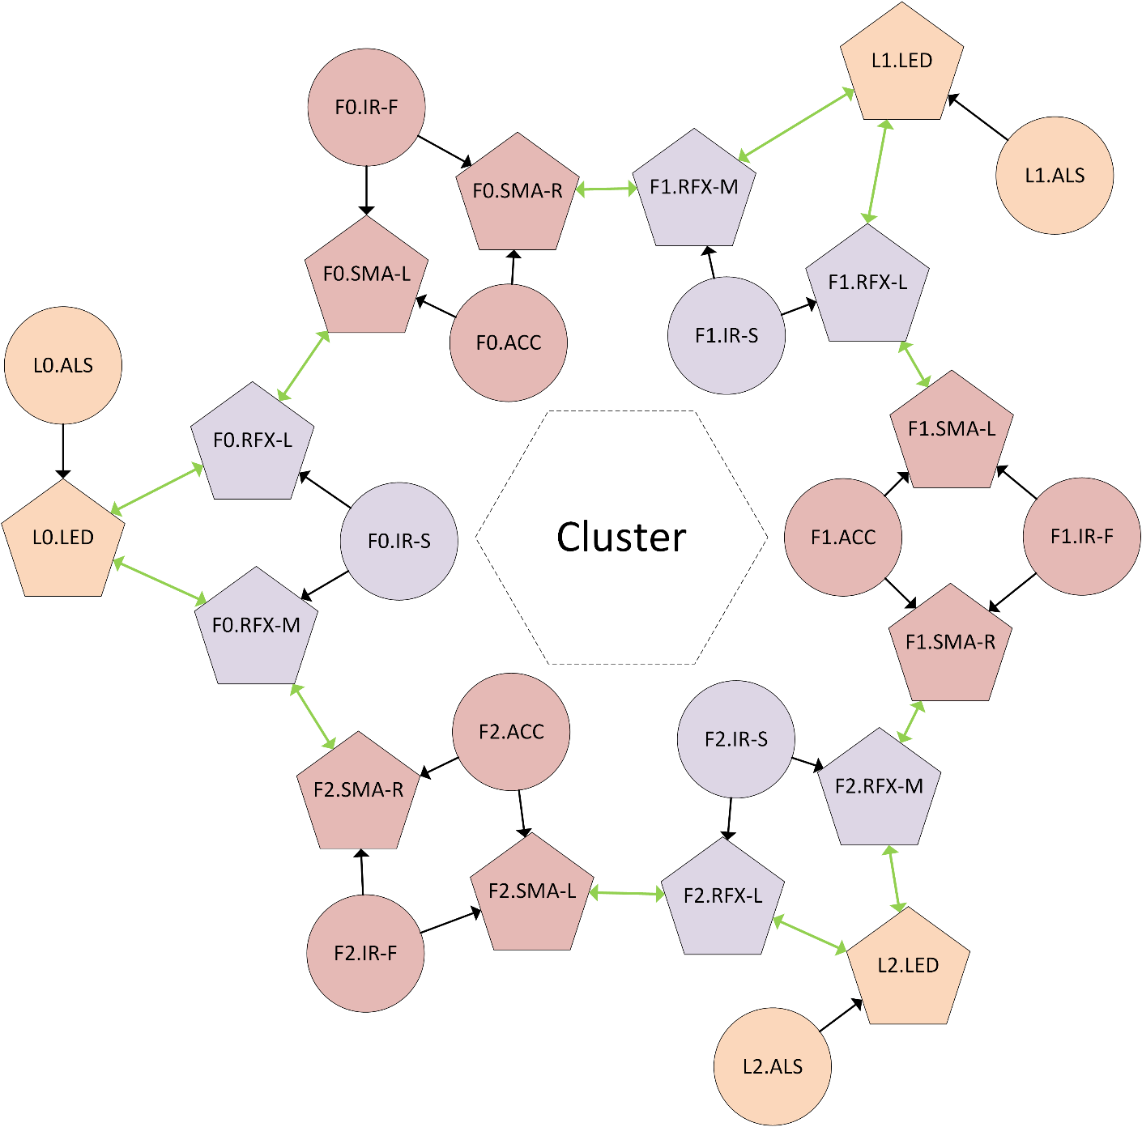
Spatial Mode
Output of a Node is a virtual input of a neighbouring Node.
Notes:
(10:35) 10s
Virtual input by proximity within a cluster.

Slide 19
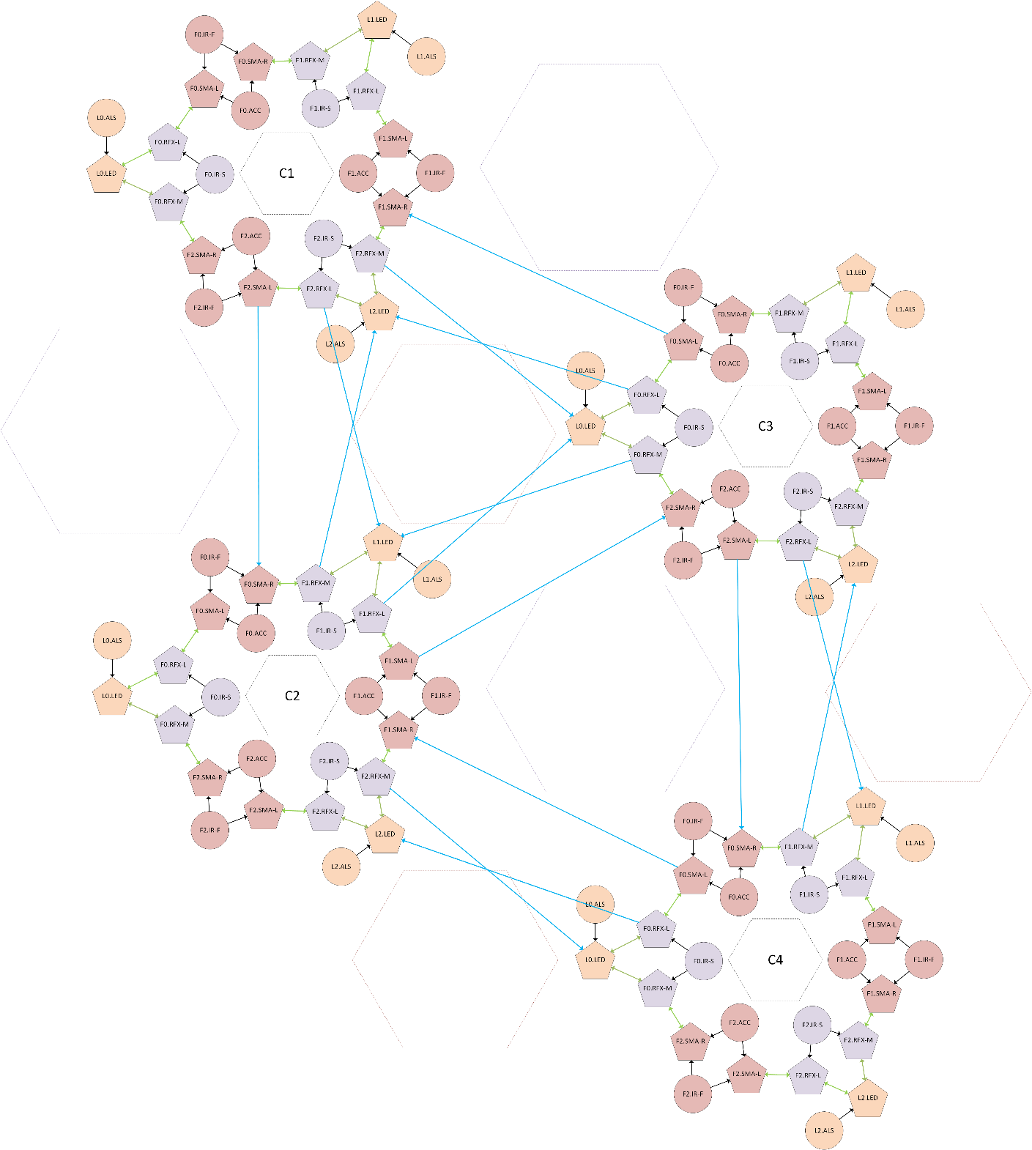
Spatial Mode
Nodes in nearby clusters are also connected via virtual inputs.
Notes:
(10:45) 10s
Also link to Nodes in neighbouring clusters.
Random Mode -> random, uniform links.
111 links in total
(Total 130s = ~2min)

Slide 20
Introduction
Curiosity-Based Learning Algorithm
Interactive Control System
Experimental Validation
User Study
Conclusions and Future Work
Notes:
(10:50) 5s

Slide 21
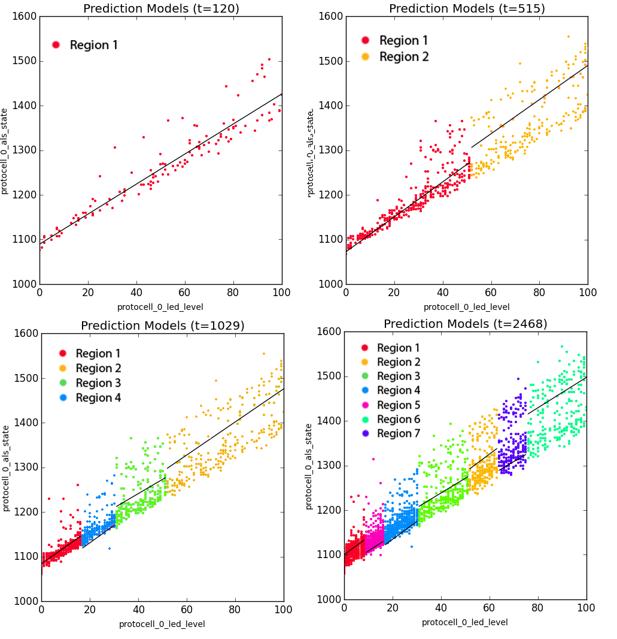
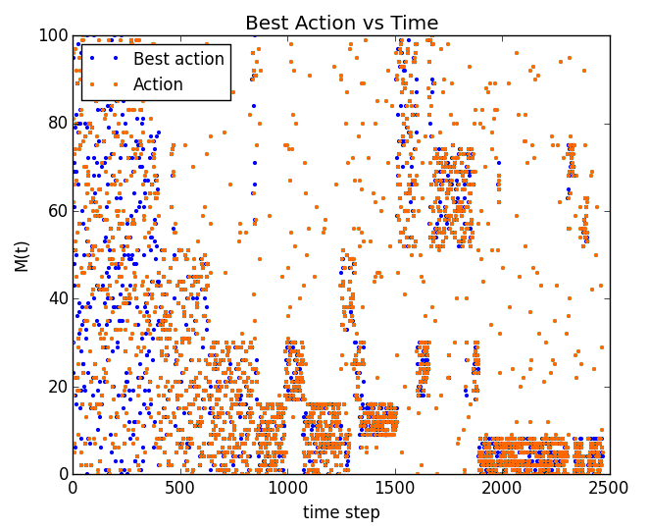
Exploration pattern of a Single Node System
A single CBLA Node with LED level as output and light intensity level as input.
CBLA explores lower variance regions before exploring higher variance regions.
Notes:
(11:40) 50s
Output -> LED; Input -> ambient light sensor.
Higher variance in the high brightness regions (considered more difficult at first).
Split it easy regions before hard.

Slide 22
Multi-Cluster Experiment
“Single Trigger” procedure
An object was placed in front of an IR sensor in Cluster 3 at the 450s point.
“No Trigger” procedure
Undisturbed in the entire experiment.
Experimented on combinations of Spatial Mode/Random Mode and low sensitivity/high sensitivity.
Hypothesis: activations of Spatial Mode should be more concentrated around the trigger location than Random Mode.
Hypothesis: the magnitude of activations of the trials using low-sensitivity setting would be more dampened compared to the high-sensitivity setting.
Notes:
(13:10) 1:30
Reaction to single disturbance at 450s.
The trigger becomes new info that it wants to learn.
In Spatial Mode, the trigger should concentrate closer to trigger.
Low intensity with low sensitivity.

Slide 23
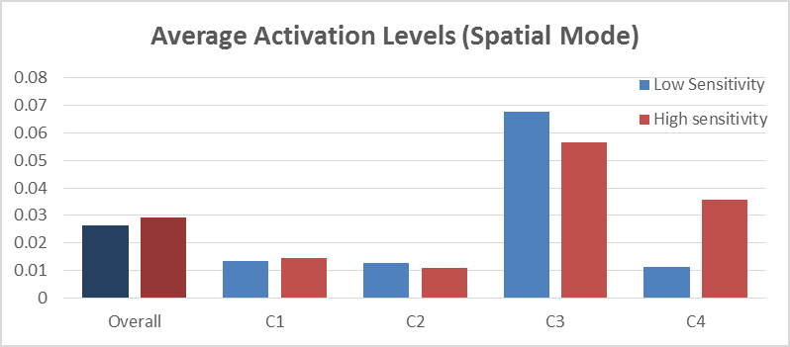
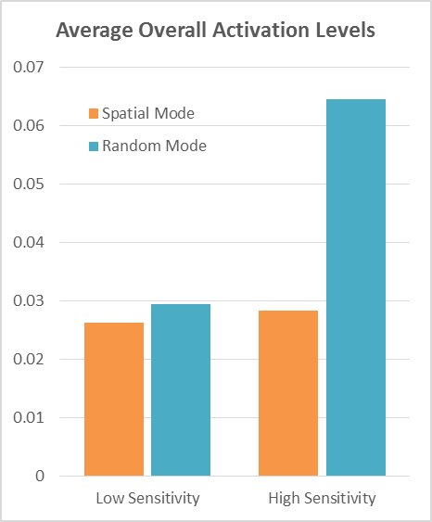
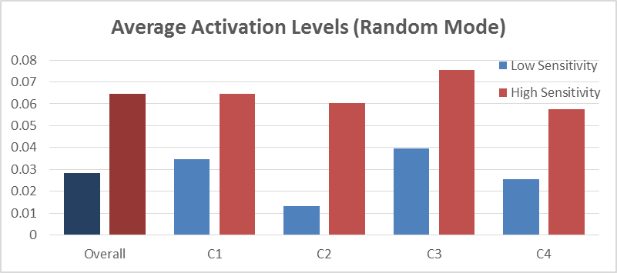
Activation Levels
Spatial Mode has relatively higher activations near the trigger’s cluster.
Higher activations with high sensitivity setting.
*Average Activation Levels were computed in the 30s after the trigger point.
Notes:
(14:10) 60s
Average activation in the 30s after the trigger.
Total activation is higher for Random Mode.
C3 has larger difference from Total activation for Spatial Mode.
The activation is lower for low sensitivity.

Slide 24
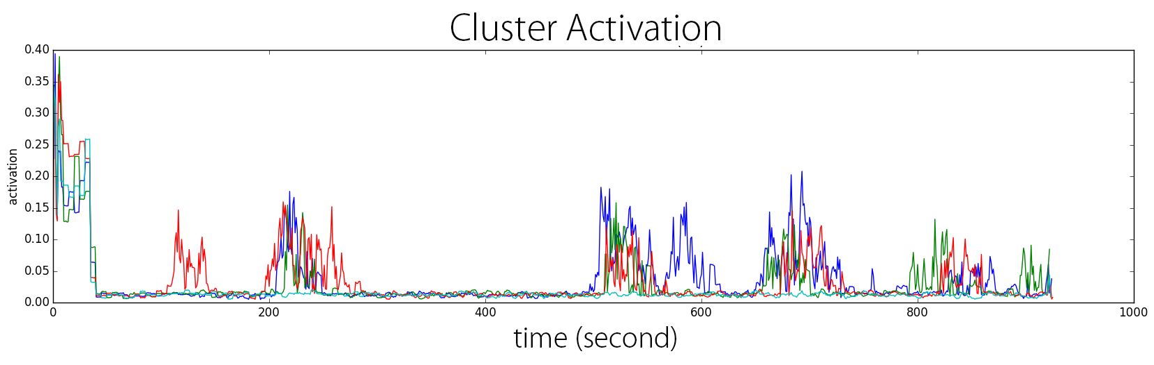
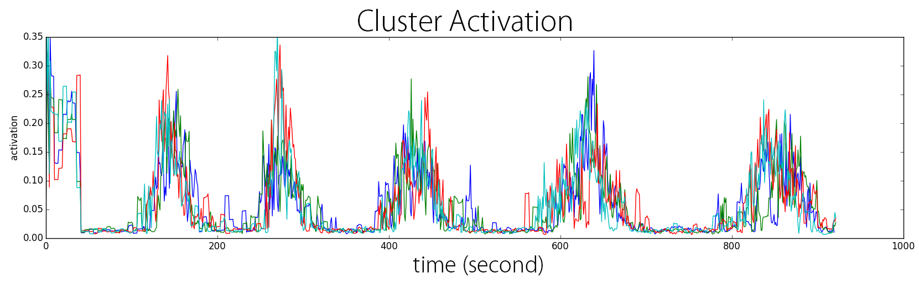
Spontaneous Activations
(a) No Trigger for Spatial Mode with high sensitivity settings
(b) No Trigger for Random Mode with high sensitivity settings
Notes:
(14:55) 45s
Activation pattern without trigger.
Initial part is the initial learning period.
More inter-cluster links -- more uniform patterns.
Believe higher activation is better even if non-triggered. Can attract attentions.

Slide 25
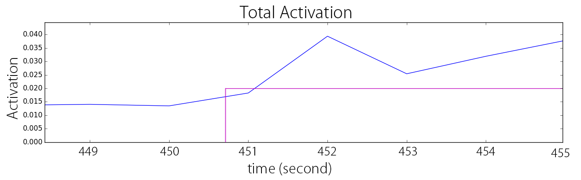
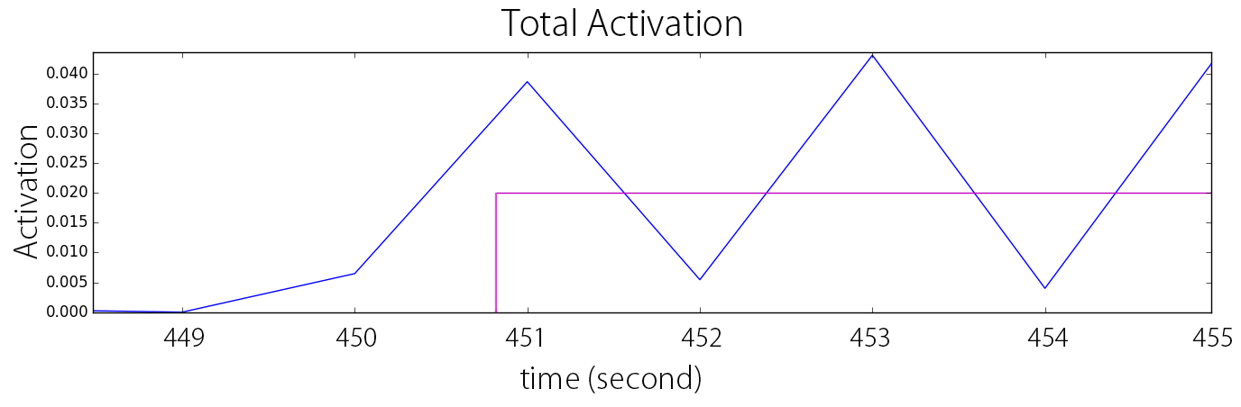
Response Time
(a) CBLA Mode
(b) Prescripted Mode
Notes:
(15:25) 30s
Small delay with CBLA. (about 1 second)
Might affect perceived responsiveness.
(Total: 280s =~4.5min)

Slide 26
Introduction
Curiosity-Based Learning Algorithm
Interactive Control System
Experimental Validation
User Study
Conclusions and Future Work
Notes:
(15:30) 5s

Slide 27
Research Questions
Does the use of the CBLA increase users’ interest level over prescripted behaviours?
Do people perceive CBLA as non-random?
Are certain behaviours more interesting than others?
Notes:
(16:25) 55s
CBLA more interesting because it’s more novel and varying.
CBLA should be perceived as non-random.
Some behaviours may be more interesting in general (high activation, proximal)

Slide 28
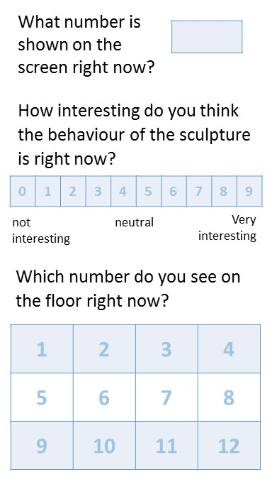
User Study Procedure
The participant interacts with the sculpture for 20 min.
During the trial, participants are asked to fill out a questionnaire card 8 times.
In the middle of the trial, the behaviour will switch from CBLA Mode to Prescripted Mode or vice versa.
The participant fills out an exit survey after the trial.
Notes:
(17:20) 55s
10 participants participated.
Participants are not PBAI staff or grad students who have worked on the project.
Interact any way for 20 min.
Full in 8 cards when beep.
Switch from CBLA Mode and Prescripted Mode in the middle.
Exit survey at the end.

Slide 29
Results
CBLA Mode was reported to be 25% less interesting than Prescripted Mode.
Reported interest level increased by 33% when switched from CBLA Mode to Prescripted Mode.
Moderate positive correlation was found between perceived responsiveness and interest level.
CBLA Mode tends to be described as “random” or “unresponsive”
Weak positive correlation was found between overall activation levels and interest level. Proximal activation didn’t show stronger positive correlation.
Notes:
(18:30) 1:10
CBLA less interesting.
Especially less interesting when switch from CBLA to Prescripted.
Positive correlation found between responsiveness and interest level.
CBLA Modes seems random.
Activation level correlate with interest level. But proximal not particularly strong.
The test bed is small.

Slide 30
Discussion
Are life-like behaviours interesting?
Several participants commented that, during the trial, they tried to discover the responsive behaviours of the sculpture.
Harder to observe causal relationship when behaviours are varying and often activate autonomously. Thus, the sculpture appears less predictable.
Did delays in the response of the CBLA make it less interesting?
Would participants who have better understanding of concepts behind the work find it more interesting?
The trials may be too short.
The user interactions in this user study may not be representative of interaction in a typical exhibition setting.
Categorization of participants might be necessary to discover more useful information about user response to different kinds of behaviours.
Notes:
(23:00) 4.5 min
Interesting if novel and comprehensible.
Being life-like might contradict.
Delay in CBLA -- difficult to recognize causal relationship, but no one reported sluggish.
Unlike typical, don’t know concepts, no previous interest.
Not long enough for users to get bored of prescripted.
People interact with people or as secondary activity.
People expect light show, or complex pattern. Might not universally interesting behaviours.
(Total: 445s = ~7.5min)

Slide 31
Conclusions
CBLA System
Autonomous behaviour generation system was developed by applying a reinforcement learning algorithm that mimics curiosity.
Extended the IAC algorithm for a distributed sculptural system by using a network of CBLA Nodes.
Adjusting the maximum activation levels based on knowledge gain potential provided visual indication of the CBLA Node’s learning process.
Interactive Control System
A new set of electronics and control software was developed to control and sample a larger number of sensors and actuators, and to run the CBLA.
User Interaction
CBLA Mode was shown to be less interesting than Prescripted Behaviours.
Weak to moderate positive correlations were found between activation levels, perceived responsiveness, and the users’ level of interest.
Notes:
(24:00) 1:00 min

Slide 32
Future Work
CBLA System
Experiment with different parameters and settings.
Enable merging of similar regions and removal of obsolete regions to enable long term operation.
User Interaction
Study the effect of response time and predictability.
Study what it is that people find interesting.
Categorize or align users’ expectations.
Design studies that better resemble the typical settings and use cases and conduct studies over a longer period of time.
Notes:
(25:45) 1:45
Parameters: sensitivity, split criteria, network config, action selection policies.
Should tell people what to expect?
(total: 165s = ~2.75min)

Slide 33
Questions?

